Slide 1

Women, Work, and the Economy: Macroeconomic Gains from Gender Equity
Kalpana Kochhar
Deputy Director, Asia and Pacific Department
International Monetary Fund
InterAmerican Development Bank
May 26, 2014
The views expressed in this presentation are those of the authors and should not be attributed to the International Monetary Fund, its Executive Board, or its management.
Notes:
Women and girls suffer disproportionately from the burden of extreme poverty—they make up 70 percent of the 1 billion people living on less than $1 a day.
Of all the people employed in the world, only 40 percent are women and this share has not changed in the last 10 years.
The share of women of working age (15 years and over) who are employed is 48 percent compared with nearly 73 percent for men. In absolute numbers, there are equal number of women and men above the age of 15 (about 2.5 billion each) but only 1.2 billon women are employment compared with 1.8 billion men.
There is a clear segregation of women in sectors that are generally characterized by low pay. Part-time work is a predominantly female domain and part-time work is paid at a significantly lower rate than full-time work.
Even controlling for education levels and hours worked, there is a significant gap between male and female median wages. Gender wage differentials are present in all occupations and across all skill bases.
Women dominate the informal sector, which is characterized by unstable earnings, vulnerability in employment status, and low degree of social protection.
Female representation in high paid senior positions in public and private sectors is very low. This exacerbates the gender dimension of income inequality.
So there are major issues with equity and human rights…but from the IMF’s point of view, our main interest is the macroeconomic criticality of this issue.

Slide 2
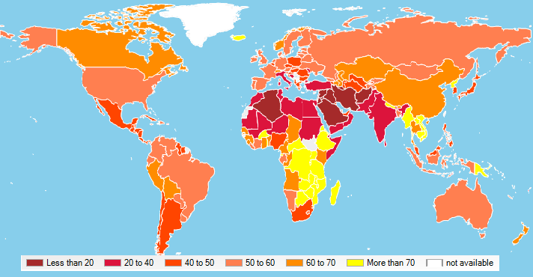
Female Labor Force Participation Rates are Low in Many Countries, …
Source: World Bank, World Development Indicators, 2013;
Key Indicators of the Labour Market (KILM), ILO.
Notes:
Labor force participation rate is the proportion of the population ages 15 and older that is economically active: all people who supply labor for the production of goods and services during a specified period
Highest participation rates in Sub-Saharan Africa (reasons on next slide)
This map depicts female labor force participation rates across countries.
Participation rates vary widely:
The situation is worst in the Middle East and Northern Africa where less than 20 pereant of the women participate in the labor market in some countries.
Highest participation rates are in Sub-Saharan Africa where women often work out of necessity but are over-represented in the informal economy
In Latin America and Caribbean, the rates have been rising over the last 20 years and we see now a relatively favorable picture
the picture is mixed in Asia, with relatively high participation rates in China, but very low ones, for example in India (a case I want to highlight later on)
Note:
(1) any border disputes are taken into account in this standard IMF map
(2) labor force participation rate is the proportion of the population ages 15 and older that is economically active, it covers all people who supply labor for the production of goods and services during a specified period

Slide 3
Progress Has on Average Stagnated over the Last 20 years.
Notes:
Female labor force participation rates have been stagnating at around 50 percent for the last 20 years.
There are different trends by region, however:
MENA: Participation rates have started to increase modestly
Latin America has made a huge progress within the last two decades (also reflected in large tertiary education rates).
Rates in East Asia have been declining, which is consistent with the U-shaped relationship between income per capita and participation rates.
South Asia has recently seen a decrease in participation rates. One of the reasons for this could be that education emerges as an alternative to going to work (women > 15 years going to school instead of joining the labor market; India)

Slide 4
Gender Gaps in Participation Rates
Remain High,…
Notes:
Good news: the gender gap in labor force participation has been shrinking in all regions over the last 20 years.
Bad news: the gap is still large in many regions, and a large part of the decline in the gaps can be actually attributed to decreasing male labor force participation rates.

Slide 5
Gender Gaps in Education
Remain Significant.
Source: World Bank, World Development Indicators, 2013.
UNESCO Institute for Statistics
Notes:
Gender gaps in school enrollment rates are shrinking, and female tertiary enrollment rates are actually exceeding male tertiary enrollment rates on average worldwide.
However, women are still much more likely to be illiterate than men, with particular high literacy gaps in South Asia and Sub-Saharan Africa.

Slide 6
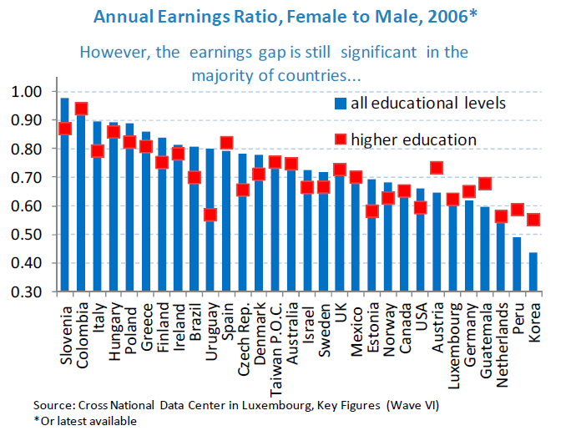
But even for similar education levels, gender wages gaps are sizable.

Slide 7
The Macroeconomic Gains from Raising Female Labor Force Participation
865 million women (Aguirre and others, 2012) have the potential to contribute more fully to national economies:
Higher Female Labor force participation
Boost Economic Growth by Mitigating the Impact of a Shrinking Workforce
Greater Opportunities to Control and Earn Income
Higher School Enrollment for Children and Stronger Human Capital
Equal Access to Inputs
Higher Productivity in Female Owned Companies
Employment of Women on an Equal Basis
Improvement in Talent Pool
Notes:
Increasing female labor force participation in itself is an important development goal
but allowing women to develop their full labor market potential can lead to significant macroeconomic gains
865 million women have the potential to contribute more fully to national economies through the following channels:
In rapidly aging economies, increasing female labor force participation can boost economic growth and help making the pension system sustainable.
Greater opportunities to control and earn income could broaden economic development through higher school enrollment for children, including girls.
Equal access to inputs would raise the productivity of female owned companies
and employing women on an equal basis would help to improve the talent pool.

Slide 8
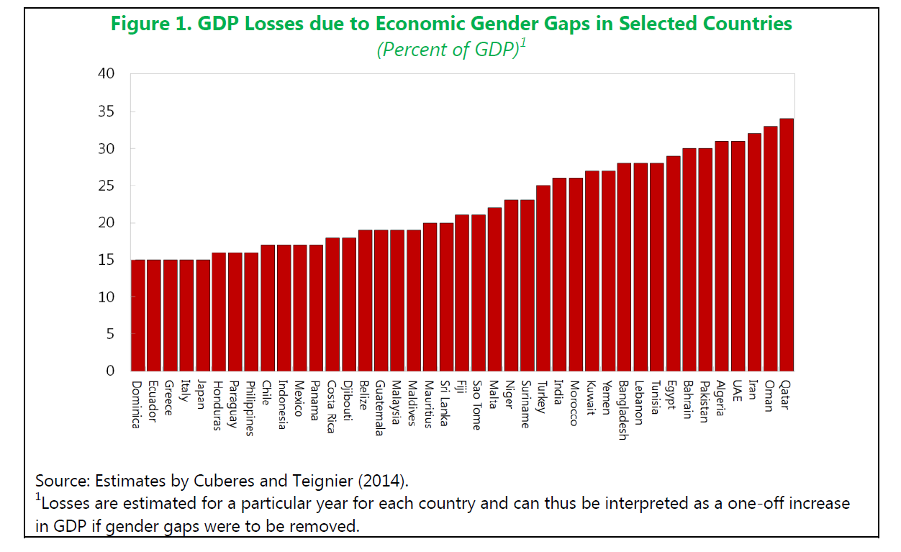
Very high opportunity costs

Slide 9
Income Losses Due to Gender Gap by Region, in Percent
Source: Cuberes and Teignier (2012)
Notes:
The income losses due to the gender gaps are studied, for example, in a working paper by Cuberes and Teignier.
The authors develop and calibrate a theoretical model which takes into account the impact of gender equity on resource allocation and aggregate labor productivity.
The idea is simple:
agents are endowed with entrepreneurial talent drawn from a fixed distribution.
the most talented ones choose to become entrepreneurs
gender inequality is modeled as an exogenous restriction on women’s access to entrepreneurship and participation in the workforce
when women are excluded from entrepreneurship, a larger fraction of men become entrepreneurs
as a result, the average talent of entrepreneurs decreases, with negative welfare consequences
Based on a calibration of the model to different regions, the authors find
27 percent income losses in MENA, and income losses of
23 percent in South Asia,
17 percent in Latin America and the Caribbean,
15 Percent in East Asia and the Pacific,
14 percent in Europe and Central Asia,
12 percent in Sub-Saharan Africa

Slide 10
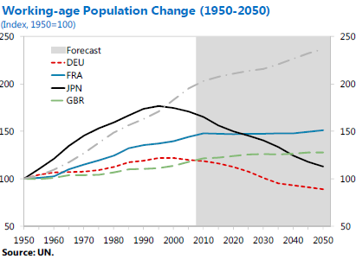
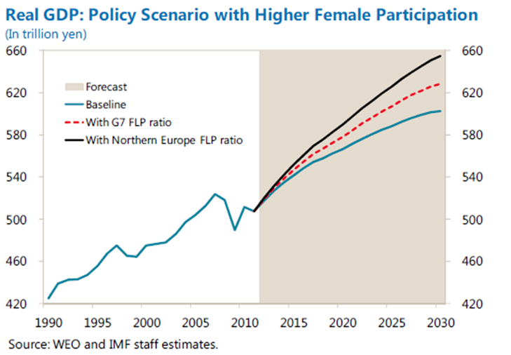
Japan: Potential for higher growth
With its population aging, Japan’s potential growth is falling
FLFP rates are well below OECD averages
Raising FLFP to G7 level would yield 4 percent GDP per capita gain and increase potential growth rate by 0.2 percentage points
Notes:
One of the examples where increasing female labor force participation is one key to preserve growth is the case of Japan
Japan is growing older faster than anywhere else in the world: After experiencing a demographic dividend of a rapidly growing
labor force and a falling birth rate from the 1960s to 1980s, Japan is now facing the consequences of a rapidly aging society (first graph shows forecasts for working age population).
But Japan has a secret weapon—an army of highly educated women who do not participate in the labor force. FLFP in Japan is 63 percent compared with rates above 70 percent in other OECD. Gender gaps are the highest (25 percent and 28 percent in Japan and Korea, compared with 10 percent in the US and 5 percent in Sweden).
Steinberg and Nakane (2012) estimate that if Japan were to raise its FLP ratio to the level of the G7 (excluding Italy and Japan), GDP per capita would be permanently higher by approximately 4 percent than under the baseline scenario. The authors estimate that increasing participation rates to Northern European Levels would add an additional 4 percent GDP per capita (second graph for the scenarios)
The potential growth rate could increase by 0.2 percentage points and 0.4 percentage points, respectively. These are significant increases in a country where potential output growth is currently estimated to be between 1 and 1 ½ percent.

Slide 11
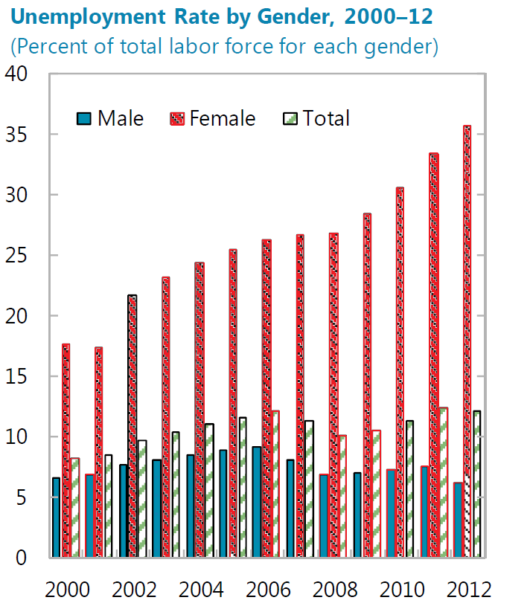
Saudi Arabia: Wasted Opportunities
Notes:
In Saudi Arabia, female unemployment rates are high and rising

Slide 12
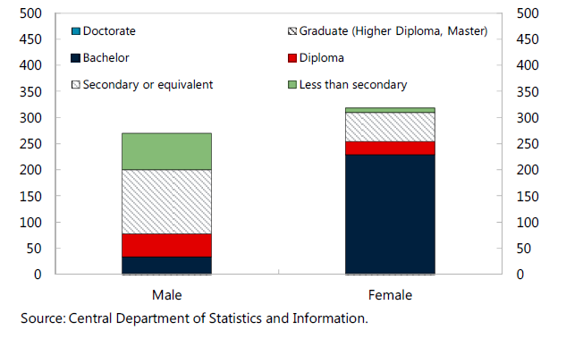
Seventy percent of unemployed women in Saudi have university degrees
Notes:
The authorities have made huge investments in higher education, but fail to include women into the labor market
with 70 percent of unemployed women holding a university degree, Saudi Arabia faces a double cost
Not providing women with opportunities decreases the economies productive potential
In particular not including educated women into the labor market, undermines the country’s path to a knowledge-based economy

Slide 13
Legal Equality Matters.
Notes:
Let me say a few words about a recent study we have conducted on the effects of legal rights on labor force participation gaps
In this study we heavily built on extensive work and data collected on legal restrictions by the World Bank with the help of which also this chart was created
This chart shows that, despite some progress over the past few years, gender-based legal restrictions remain significant.
Almost 90 percent of countries have at least one important restriction in the books, and some have many.
These range from the requirement for women to seek their husband’s permission to work, to laws that restrict women’s participation in specific professions. Others constrain the ability of women to own property, or to inherit, or to obtain a loan
I will not go into the details of our methodology and the details of the study here.
But let me highlight the main findings:
We find a strong relationship between legal restrictions and female labor market participation.
In 50 percent of the countries, a change in the law to guarantee women equality constitutionally, female labor participation rates increased by at least 5 percentage points over the following five years.
In Peru, legal changes went hand in hand with particularly large changes in female labor force participation.
In 1993, the new constitution granted equality between men and women under the law, and it eliminated discrimination by guaranteeing equal opportunities for work. Customary law was invalidated if it contradicted these rights. Women’s labor force participation increased by a striking 15 percent.
This “anecdotal” evidence holds also in different empirical specifications for both advanced and developing countries.
In particular, we find that, while that the many legal rights examined are important individually by themselves, the joint effect can be even larger.
We find that, for example, the joint effect of guaranteed equity, more equal inheritance rights, and the legal right for of women to be the head of a household is associated with a larger decline in gender gaps in labor force participation of around 4.6 percentage points

Slide 14
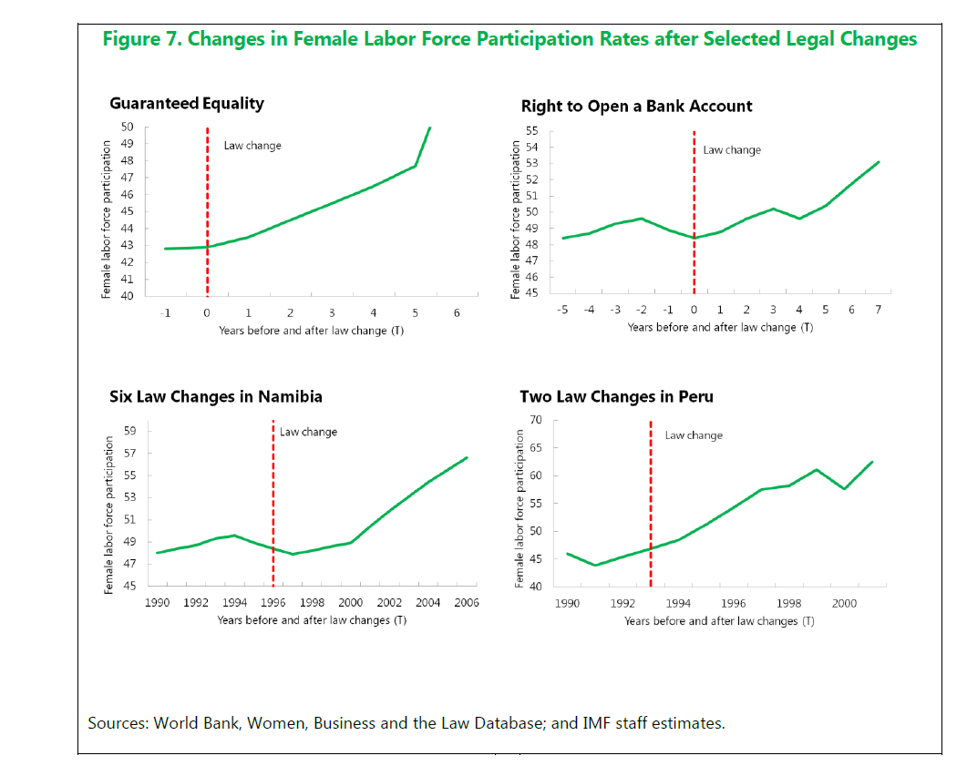
Changes in Laws can be powerful
Notes:
Favorable changes in the laws have been found to have strong effects on FLP. For example, Namibia passed the Married Persons Equality Act which triggered six change in the WBL classification. In particular, the law equalized property rights for married women and granted women the right to sign a contract, head a household, pursue a profession, open a bank account, and initiate legal proceedings without the husband’s permission. In Peru, customary law was abolished and was invalidated if it violated the nondiscrimination clause. Namibia and Peru experienced substantial increases in FLP rates of 10 and 15 percentage points in the decade following the change.

Slide 15
Policies to Increase
Female Labor Force Participation
Need to work on many margins
Employment , promotion, and wage policies
  Access to education
  Access to credit
  Legal and property rights
Policies to facilitate balancing family and work responsibilities
  Parental Leave
  Child care
  Flexible Work Arrangements
Notes:
Providing women with equal economic opportunities will require an integrated set of policies, including anti-discrimination laws.
And policy changes are at most necessary conditions but by no means sufficient.
And not all issues can be addressed through public policy—cultural, societal and religious norms are not easily influenced by economic or social policies.
Many of these policies fall outside of the core area of expertise of the Fund, and we will need to collaborate with other international institutions on these topics (e.g. financial inclusion).
The staff discussion note – and this presentation – therefore focuses on one core area at the Fund: fiscal policy.

Slide 16
Tax Measures
Replacing family income with individual income taxation
Secondary earners are mostly women
Female labor supply more responsive to taxation than male labor supply
⇨ Efficiency gains and better labor market outcomes
Tax credits or benefits for low-wage earners
“In-work” credits reduce net tax liability
⇨ increase net income gain from accepting a job
Phasing out with rise in individual income
⇨ encourage secondary earners to remain in the labor force
Notes:
Replacing family income with individual income taxation
Empirical studies indicate that female labor supply is more responsive to taxes
As secondary earners are mostly women, replacing family taxation by individual taxation would decrease women’s marginal tax rates, thus stimulating higher female labor force supply
This can potentially generate large efficiency gains and improve aggregate labor market outcomes
Tax credits for low-wage earners
“in-work” tax credits reduce the net tax liability – they can even make it negative for low-wage earners
with lower net tax liability, the benefit from accepting a job rises
in countries which aim at supporting INCOME: “in-work” tax credits are faced out with FAMILY income (e.g. Canada, France, Ireland, Korea, UK)
in countries which aim at LABOR FORCE support: credits phased out with INDIVIDUAL income (e.g. Belgium, Finland, Sweden) – this is the preferred option to increase FLFP as the marginal tax rate applied to secondary earners will generally be lower.

Slide 17
Expenditure Measures
Publicly financed parental leave schemes
Greater parity in paternity and maternity leave
Improved access to comprehensive, affordable and high-quality child care
Pensions: ensure that spells from maternity leave do not translate into lower pensions
Higher spending on education of women
Improvements in rural infrastructure
Notes:
Publicly financed parental leave schemes can help parents reconcile work and family life, and maintain connection to labor market by guaranteed return (average duration of paid parental leave 26 weeks in OECD)
Too long periods outside of the labor market, however, risk reducing skills and likelihood of rejoining
greater parity between maternity and paternity leave could support a more rapid return to work among mothers
Better access to childcare frees up women’s time to spend in formal employment: Studies show that reducing the price of childcare by 50% could increase labor supply by young mothers by 6.5 to 10 percent.
Spells from maternity leave should not translate into lower pensions
For developing countries, improving educational attainment and better quality infrastructure are key:
Educational attainment correlates strongly and positively with female labor force participation (Turkey: only 17 % of illiterate women participate in the labor force, but 70 percent of those holding a graduate degree)
Better quality of infrastructure (access to clean water, transportation), especially in rural areas, can reduce time women spent on domestic tasks

Slide 18
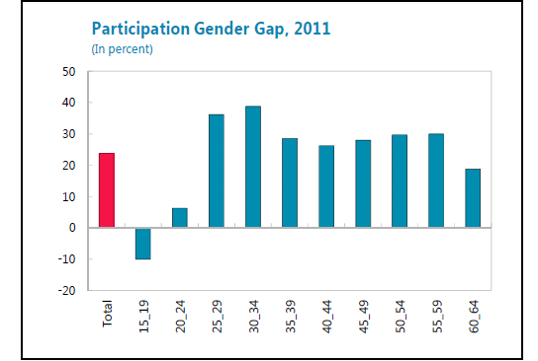
Korea: Missed opportunities
Notes:
In Korea, FLP rates have increased markedly over the last two decades from 50 percent in 1990 to 59 percent in 2011. But significant gender gaps in participation remain. Male participation rates are still 22 pecent higher than for females, with the gender gaps being particularly high (more than 35 percent) for ages 30-39, the prime working age.

Slide 19
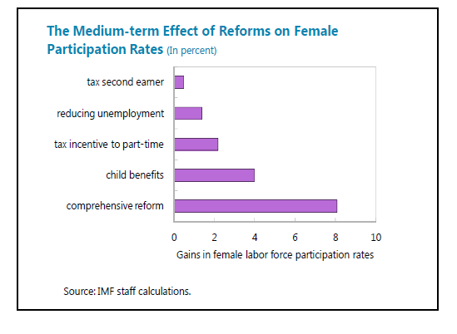
Korea: An illustration of the impact of more women-friendly policies
Notes:
LPR = constant, time fixed effects, set of policy variables found to be robust determinants of female participation
Chart presents the increase in female participation that can be achieved under various reforms scenarios.
Reform in the tax treatment of second earners yields a gain of ½ percentage point
Policies aimed at reducing unemployment will yield 1.4 percentage points (proxied by an increase in the probability of being employed)
Reform of tax incentives to part-time work gets 2 percentage points
Reforms aimed at closing the gap in child benefits between Korea and the benchmark OECD countries yields an increase in 4 percentage points
Together they would yield 8 percentage point increase and reduction in gap by 33 percent.

Slide 20
Case Study: India’s female labor force participation is very low
Notes:
Female labor force participation in India is among the lowest in emerging markets. Only about a third of working age women in India work, which is one of the lowest among the G20 and BRICs.
Also, the gender gap in participation is one of the largest in the G20 at 50 percent. Male participation rates are in line with other countries, around 80-85 percent.
Female participation in India has dropped over the past decade, this trend is in contrast to that observed in other regions.
There is considerable inter-state variability across states. States in the South and East of India (such as Andhra Pradesh, Tamil Nadu, Sikkim) generally displaying higher participation rates than those in North India (such as Bihar, Punjab and Haryana). The FLFP rates vary from just 5 percent in Bihar to 60 percent in Sikkim. There are clearly state-level and regional factors at play.
Such a low FLFP rate has a large economic cost. Model based estimates are used to assess the relationship between gender inequality and economic growth at the macroeconomic level, emphasizing the efficiency losses generated by these inequalities. Gender gaps lead to the output losses, which are large in India (at 26 percent).

Slide 21
India: Policies Can Make a Difference
Labor market outcomes for women can be improved through a number of policies:
  More flexible labor markets will help job creation for men and women, and disproportionately for women.
  Investment in infrastructure, such as better availability of public transport, can foster female economic participation.
  Higher social sector spending also helps. This includes spending on education and health.
Notes:
We recently prepared a working paper on this issue for India. This working paper studies the determinants of female labor force participation and looks at state level policy drivers of female labor force participation.
We find that demographics attributes such as age as martial status matter, as does education and household income. Additionally, more women work when labor markets are made more flexible, infrastructure improved and social spending enhanced.
Specially, a number of policy initiatives could be used to address this gender gap in Indian labor force participation.
These include increased labor market flexibility (which could lead to the creation of more formal sector jobs) allowing more women, many of whom are working in the informal sector, to be employed in the formal sector.
In addition, supply-side reforms to improve infrastructure and address other constraints to job creation could also enable more women to enter the labor force.
Finally, higher social spending, including investment in education, can also lead to higher female labor force participation by boosting female stocks of human capital and directly by incentivizing women to work as their job prospects improve with education.

Slide 22
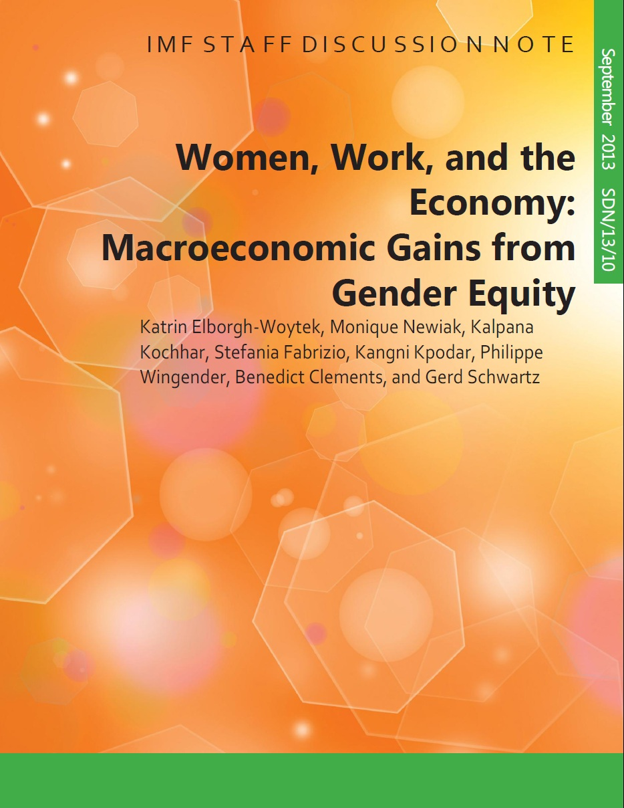
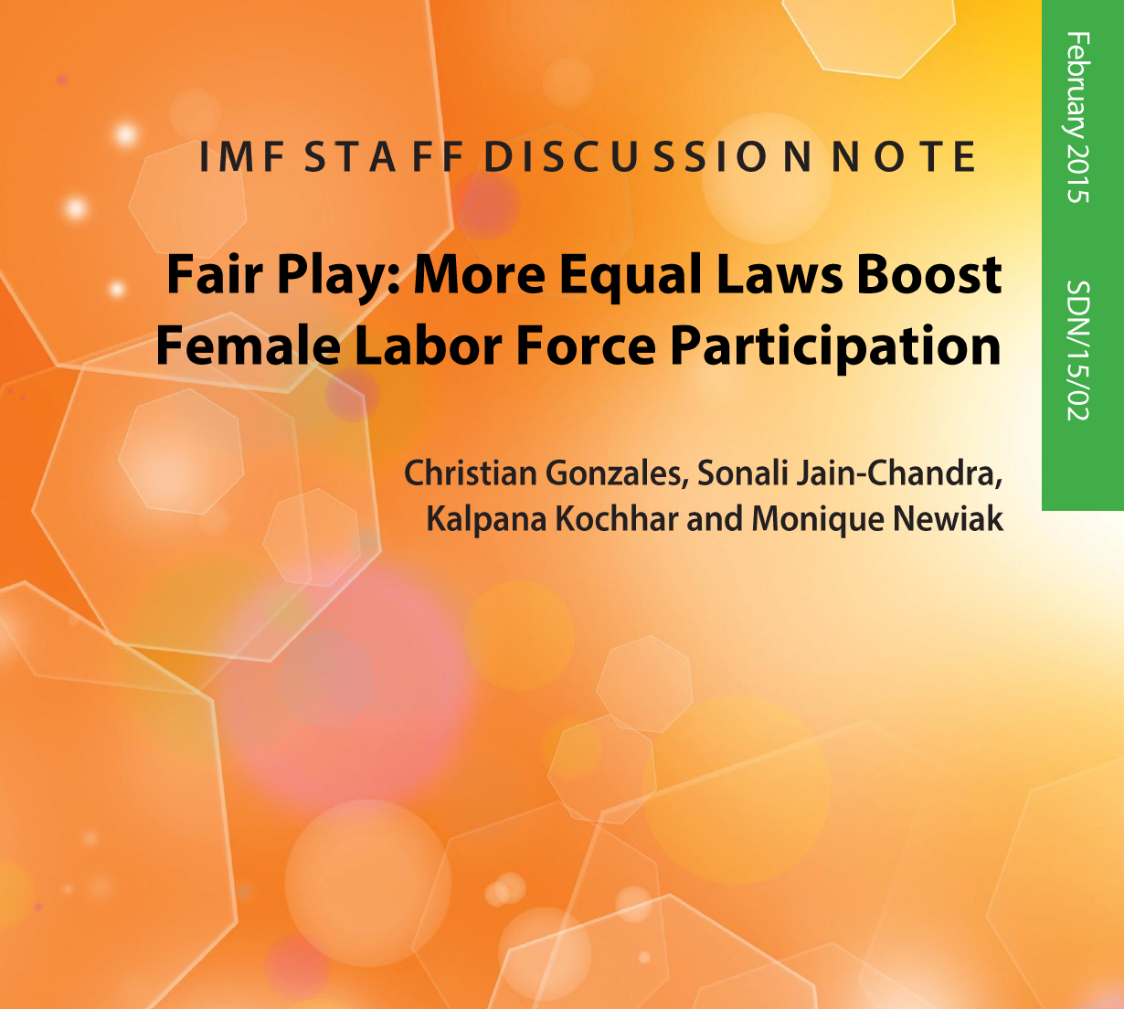
Thank you!

